Slide 1
Develop Language
Expanding and Reducing Sentences​

Slide 2
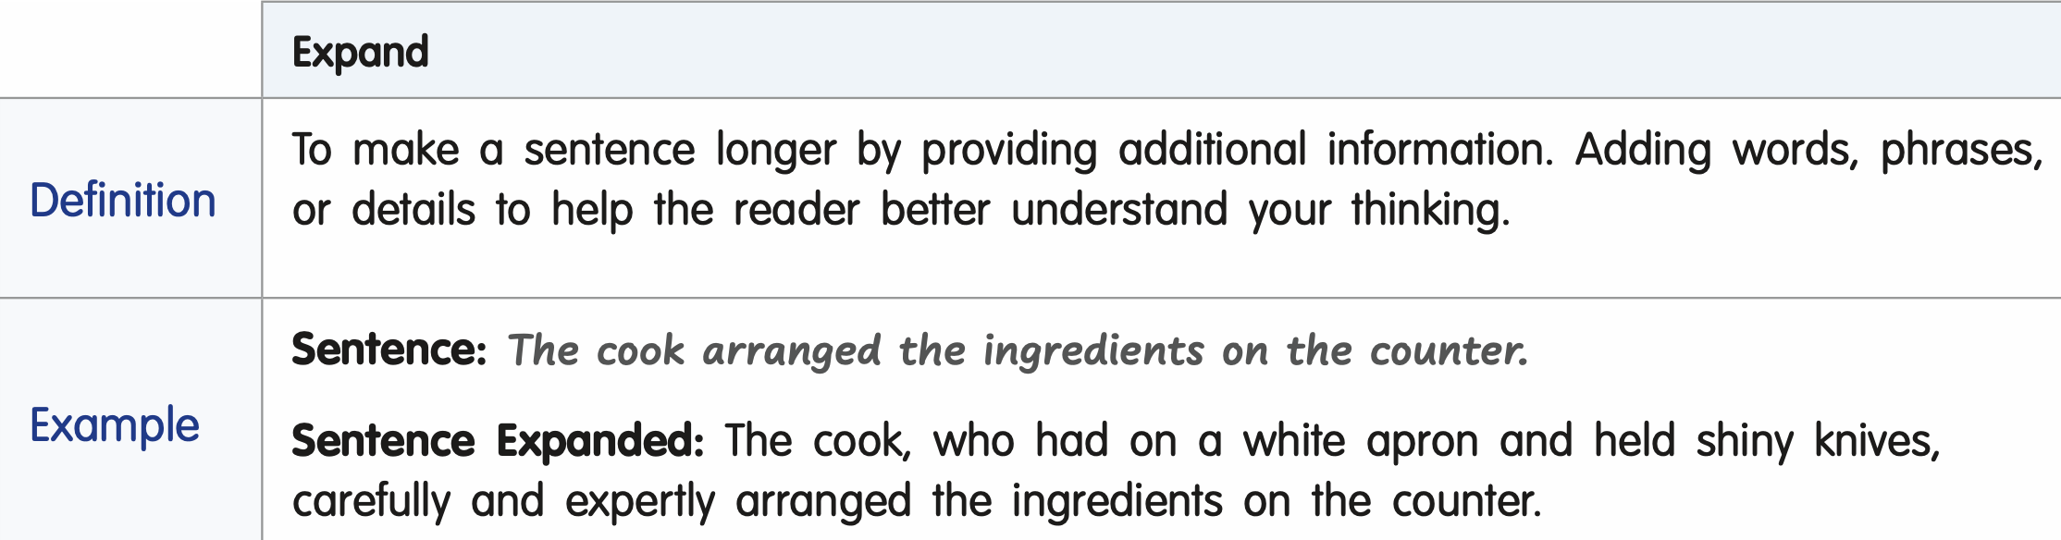
Collaborate
  What questions did the expanded version answer?
  How did expanding this sentence improve it?
Learning Outcomes
  I will expand and reduce sentences.
    Teach
      Writers expand sentences to add important details that help readers better understand what is happening.
      When expanding a sentence, writers think carefully about which details will help the reader clearly picture the idea.
Ask Yourself:
Who?
What?
Where?
When?
Why?
How?
Notes:
Expand and Reduce Sentences
Writers expand sentences to add important details that help readers better understand what is happening.
Read aloud the definition of expanding sentences.
When expanding a sentence, writers think carefully about which details will help the reader clearly picture the idea.
One way to do this is by asking: Who? What? Where? When? Why? How?
These questions help writers decide what details to add.
Read aloud the sample sentence and the expanded sentence, then ask:
What questions did the expanded version answer? (Sample responses: How: “carefully and expertly”; Who: “had on a white apron and held shiny knives”)
How did expanding this sentence improve it? (Sample responses: It’s more descriptive; I can visualize this cook and imagine the counter.)

Slide 3
Collaborate
  Turn and Talk: What additional details would help the reader better understand this sentence?
  Record your expanded sentence.
Learning Outcomes
  I will expand and reduce sentences.
Practice Expanding a Sentence:
Then, she began to cook.
Ask Yourself:
Who?
What?
Where?
When?
Why?
How?
Turn and Talk
  Listen
  Think
  Turn
  Talk
Notes:
Expand and Reduce Sentences
Now, it is your turn to expand a sentence. Use the Turn and Talk Protocol to discuss what additional details would help a reader better understand this sentence. Choose at least two of the questions, Who? What? Where? When? Why? or How? to help you expand it. Then, write your expanded sentence on the lines provided.
Have students expand this sentence: “Then, she began to cook.”
Call on several students to share their expanded sentences. As each sentence is shared, have the class identify which questions the writer answered by adding details. Invite the writer to explain why they chose those details.

Slide 4
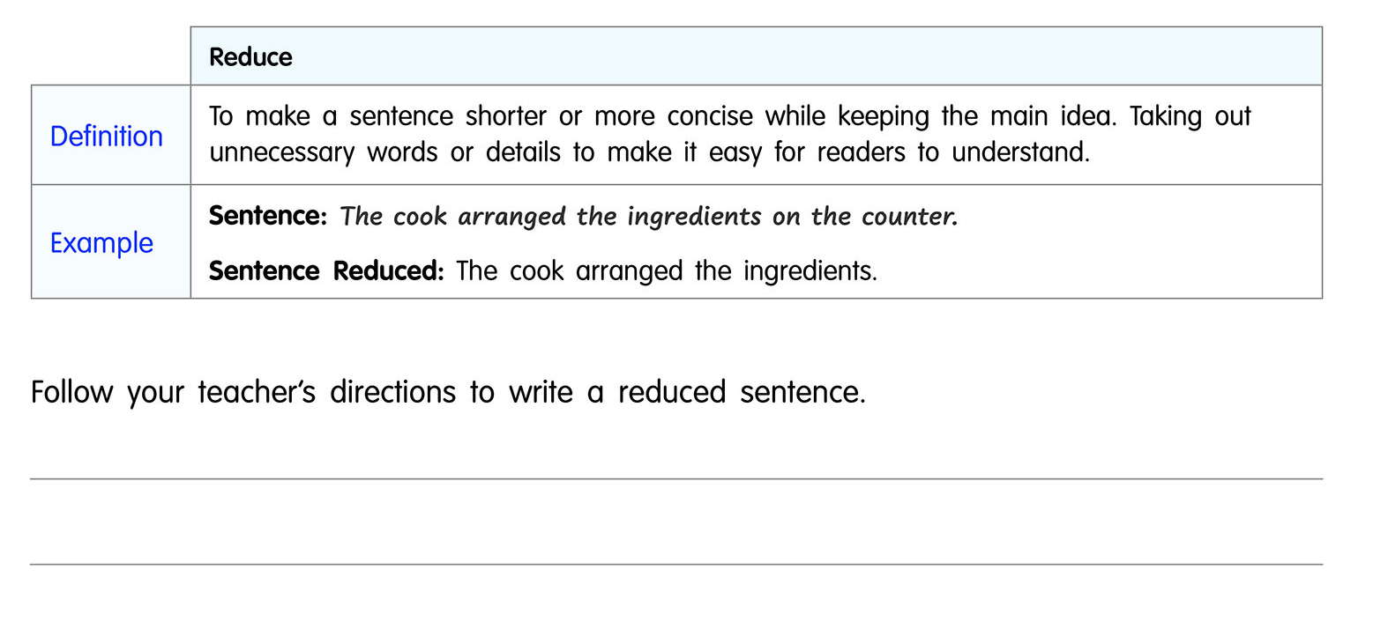
Collaborate
  What part of the sentence was removed?
  How did reducing the sentence improve the writing?
Learning Outcomes
  I will expand and reduce sentences.
    Teach
      Writers reduce sentences to make their ideas clearer and more concise.
      When reducing a sentence, writers remove unnecessary words or details, so the most important idea is clear.
Ask Yourself:
Notes:
Expand and Reduce Sentences (ANIMATED SLIDE)
Display and direct students to the Reduce section of the page.
Writers reduce sentences to make their ideas clearer and more concise.
Read aloud the definition of reducing sentences.
When reducing a sentence, writers remove unnecessary words or details, so the most important idea is clear.
Read aloud the example sentence and the reduced sentence.
What part of the sentence was removed? (Where?; on the counter)
How did reducing the sentence improve the writing? (Sample responses: It is easier to understand; it focuses on the most important idea.)
Writers decide which details are necessary and which details can be removed without changing the main idea.

Slide 5


Collaborate
  Turn and Talk: What information can be removed to make this sentence more concise?
  Record your reduced sentence.
Practice Reducing a Sentence
Learning Outcomes
  I will expand and reduce sentences.
    Teach
        See notes.
The cook lifted the lid on the pot of water to check to see if it was boiling yet.
Turn and Talk
  Listen
  Think
  Turn
  Talk
Notes:
Expand and Reduce Sentences
Direct students to use the Turn and Talk Protocol to discuss how to reduce a sentence.
Display and read the sentence: The cook lifted the lid on the pot of water to check to see if it was boiling yet.
Release students to discuss with their partner how to reduce the sentence. Have students write a reduced version of the sentence.
Allow 2 minutes for students to write.
Call on 3–4 students to share their reduced sentences.
Confirm that students understand that reducing sentences helps writers communicate ideas clearly by focusing on the most important information.
__________________________________________________
EXTEND Build Sentence Fluency by directing students to expand or reduce their sentences.
Challenge students to write two simple sentences.
Then, direct students to expand or reduce their sentences based on a specific audience or purpose.
For example:
Expand this sentence to make it more persuasive.
Or
Reduce this sentence and make it an opinion.
By expanding or reducing sentences with a specific intent, students practice analyzing tone, clarity, and word choice, which enhances their ability to write purposefully and flexibly across various contexts.

